Slide 1
The Cool Code Consortium
6-22-2017
Notes:
Use this for Pro Audio Segments

Slide 2
Stuff
What do we know?
What do we want to know?
High Level vs. Low Level
Cool News
Android App Development
Next Week

Slide 3
Google Form

Slide 4
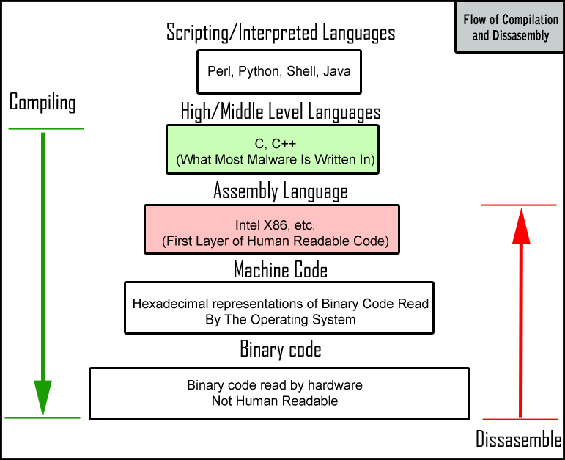

Slide 5
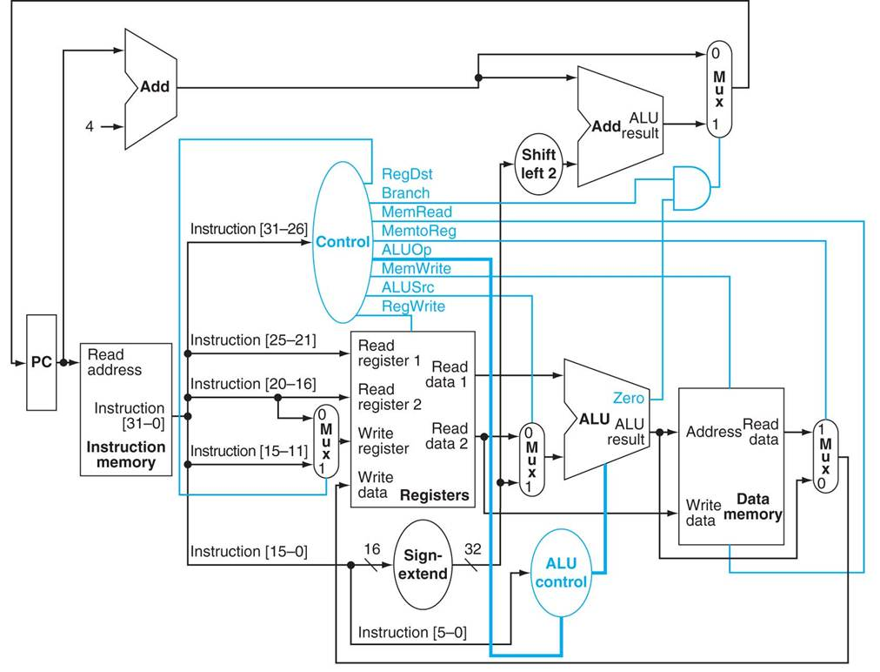

Slide 6
Cool News
https://hackernoon.com/how-it-feels-to-learn-javascript-in-2016-d3a717dd577f
http://www.codenewbie.org/blogs/object-oriented-programming-vs-functional-programming

Slide 7
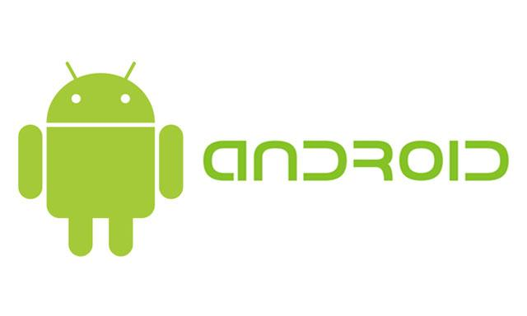
Android App Development
What is an app?
How is it designed?
Which apps are being developed by Shure?
What’s new in the Android world?
Hello World demo app

Slide 8
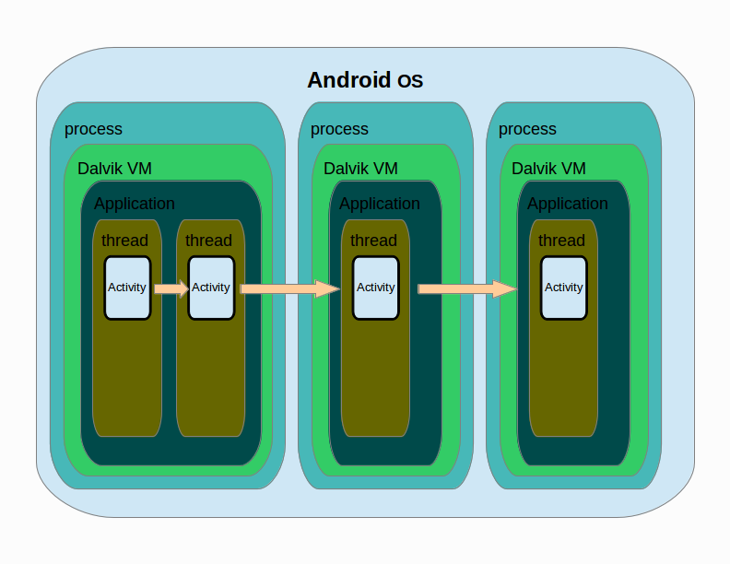
An app is a program which runs inside a virtual machine
Notes:
The Android operating system is a multi-user Linux system in which each app is a different user.
By default, the system assigns each app a unique Linux user ID (the ID is used only by the system and is unknown to the app). The system sets permissions for all the files in an app so that only the user ID assigned to that app can access them.
Each process has its own virtual machine (VM), so an app's code runs in isolation from other apps.
By default, every app runs in its own Linux process. The Android system starts the process when any of the app's components need to be executed, and then shuts down the process when it's no longer needed or when the system must recover memory for other apps.

Slide 9
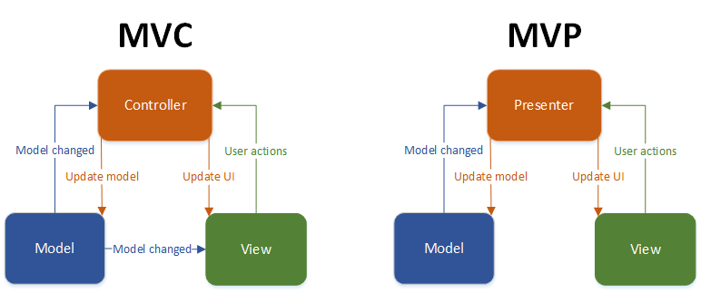
Apps are built using the Model-View-Controller pattern

Slide 10
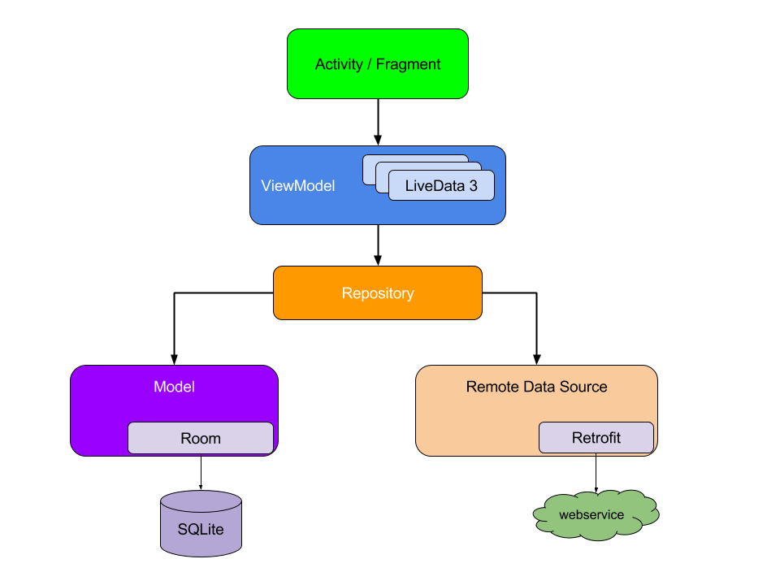
Recommended app architecture separates concerns

Slide 11
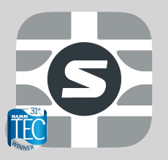
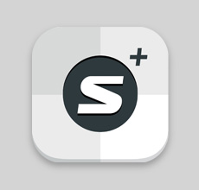

Shure is developing several apps for Android users
?

Slide 12
SOLID gives us good guidance when making design decisions
S
Single Responsibility Principle
O
Open-Closed Principle
L
Liskov Substitution Principle
I
Interface Segregation Principle
D
Dependency Inversion Principle
Notes:
Object-oriented developers chant this in their sleep…

Slide 13
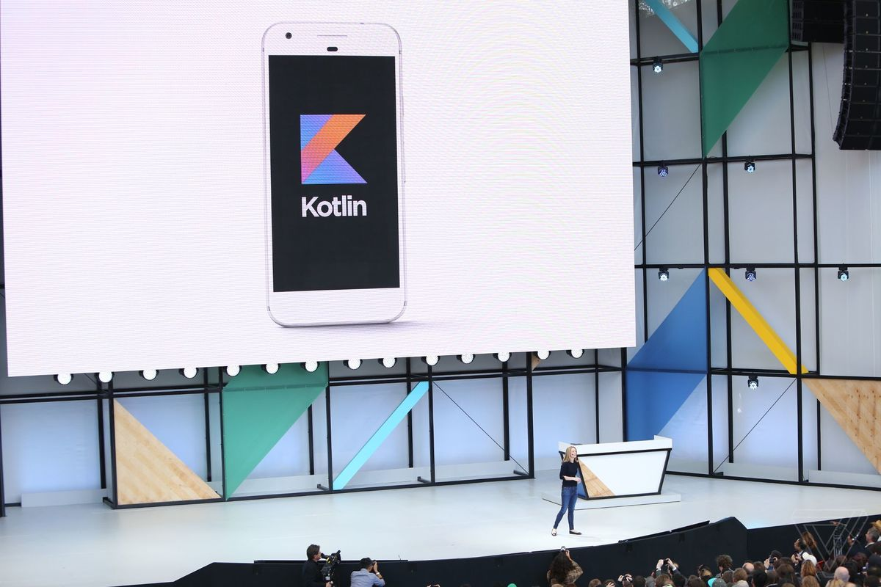
Kotlin is officially supported for Android as of May 2017
Notes:
Kotlin is an Android-compatible language that is concise, expressive, and designed to be type- and null-safe. It works with the Java language seamlessly, so it makes it easy for developers who love the Java language to keep using it but also incrementally add Kotlin code and leverage Kotlin libraries. Also, many Android developers have already found that Kotlin makes development faster and more fun, so we want to better support these Kotlin users. You can read more about Kotlin and Android here.

Slide 14
Demo

